Slide 1
Heart Failure Prediction
Using Machine Learning Algorithms

Slide 2
MAJOR PROJECT
SUBMITTED BY:
SHIVAM VISHWAKARMA
0225CS181049
SUBMITTED TO:
Prof. Vishal Paranjape

Slide 3
About Cardiovascular Diseases
Cardiovascular diseases (CVDs) are the number 1 cause of death globally.
Taking an estimated 17.9 million lives each year.
Which accounts for 31% of all deaths worldwide.
4 out of 5 CVD deaths are due to heart attacks and strokes.
And one-third of these deaths occur prematurely in people under 70 years of age.

Slide 4
Dataset
In this Exploratory Data Analysis (EDA) I have examined the dataset named as "Heart Failure Prediction" under the 'heart_failure_clinical_records' "csv" file at Kaggle website.
This dataset was created by combining different datasets already available independently but not combined before. In this dataset, 5 heart datasets are combined over 11 common features which makes it the largest heart disease dataset available so far for research purposes. The five datasets used for its curation are:
Cleveland: 303 observations
Hungarian: 294 observations
Switzerland: 123 observations
Long Beach VA: 200 observations
Stalog (Heart) Data Set: 270 observations
Total: 1190 observations, Duplicated: 272 observations, Final dataset: 918 observations

Slide 5
Idea behind project
People with cardiovascular disease or who are at high cardiovascular risk (due to the presence of one or more risk factors such as hypertension, diabetes, hyperlipidaemia or already established disease) need early detection and management wherein a machine learning model can be of great help.

Slide 6
Tools
Python
StreamLit
Numpy
Pandas
Matplotlib
Scikit Learn
XGBOOST
Lightgbm
Plotly
Cufflinks

Slide 7




System Requirements
Any Device
Browser
Internet

Slide 8
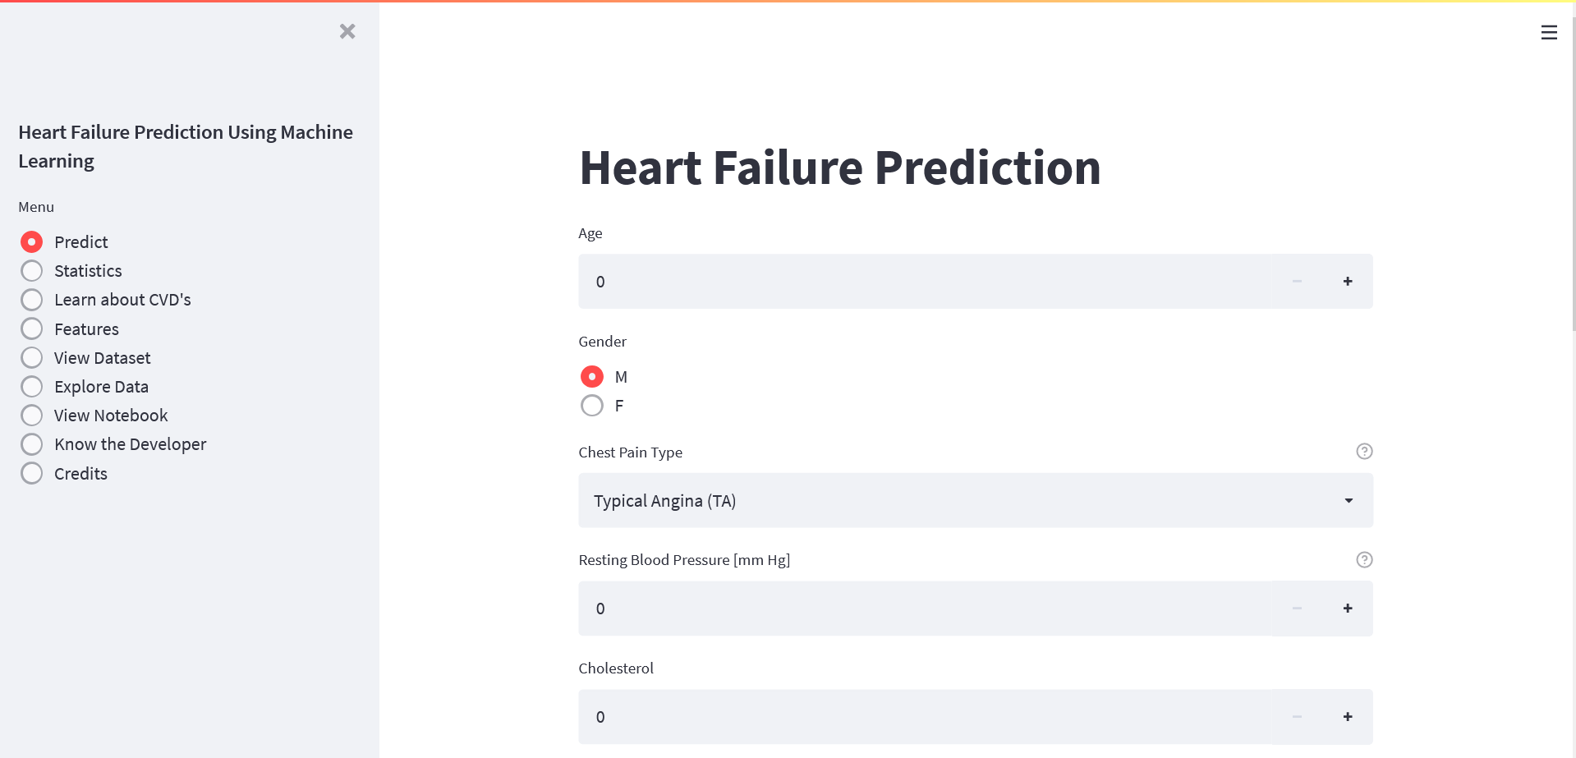


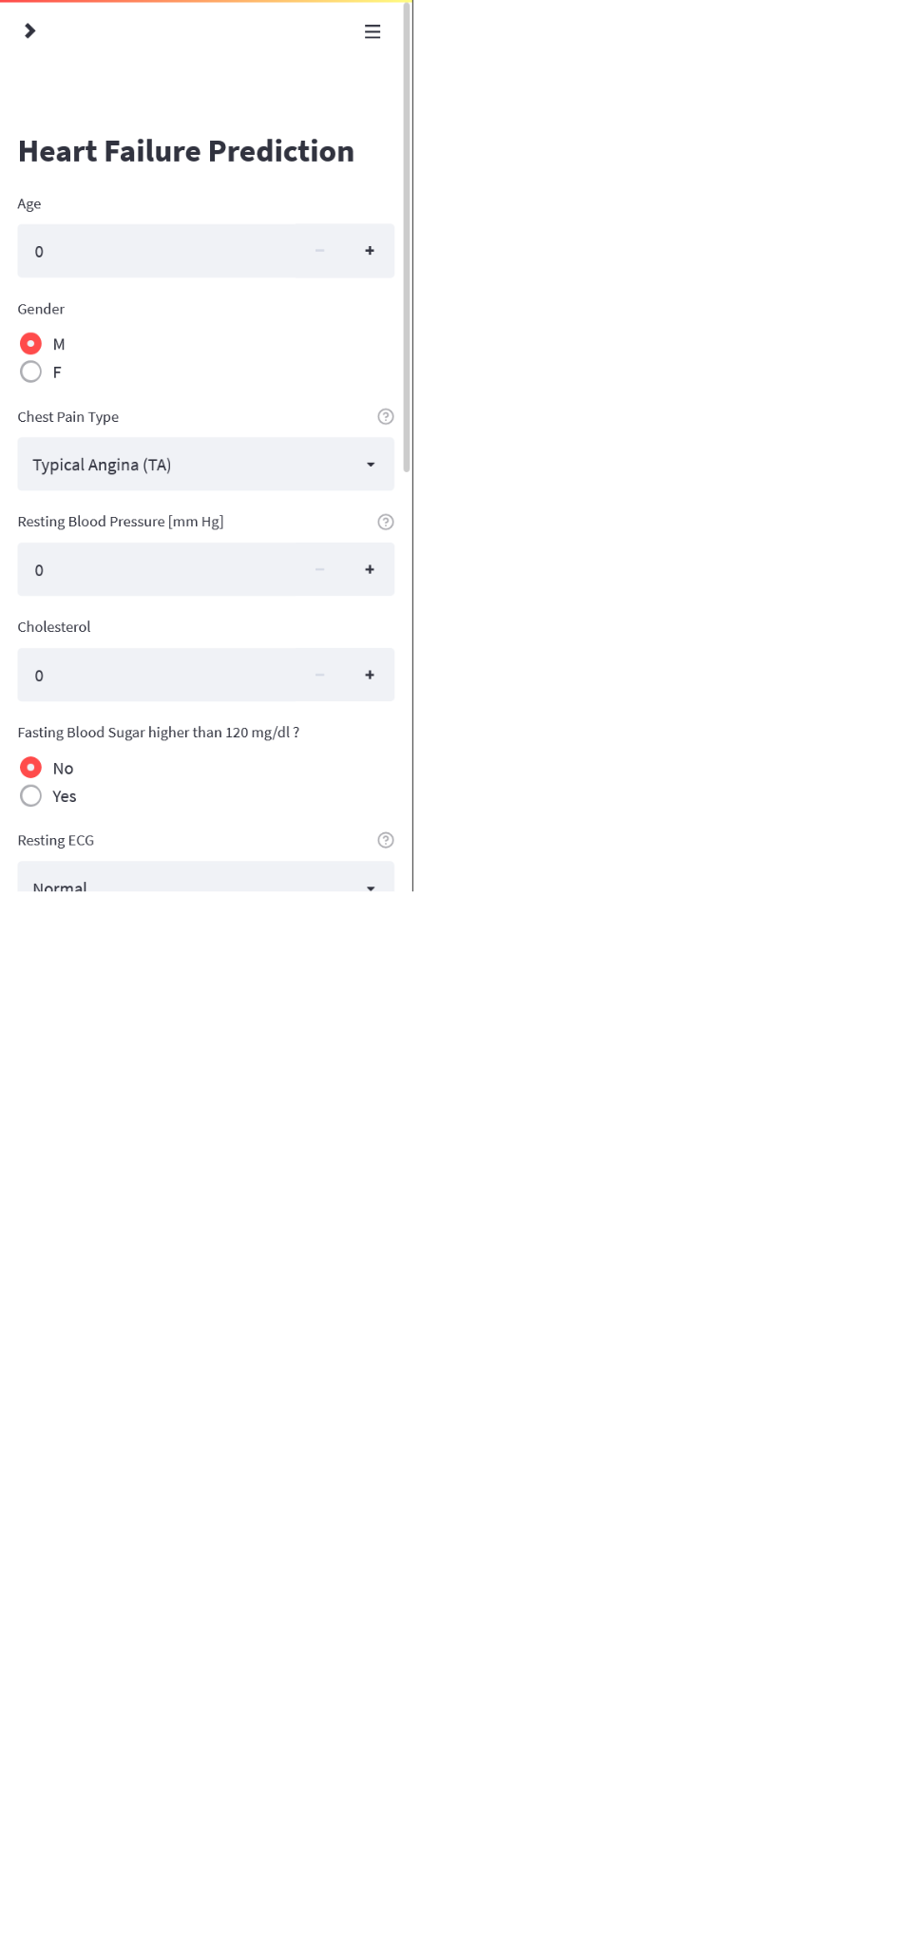
Web
Server
Model

Slide 9
About Model
- Based on the data and data dictionary, I have a classification problem.
- I have to make classification on the target variable Heart Disease
- And I will build a model to get best classification possible on the target variable.
- For that I will have to look at the balance of the target variable.
- I have to check various model to get most accurate prediction.
- For that reason we will use Accuracy Score.

Slide 10
About dataset features
The dataset I am using contains 11 features
AGE​ | GENDER​ | CHEST PAIN TYPE​ | RESTING BP​
CHOLESTROL​ | FASTING BS​ | RESTING ECG​ | MAX HEART RATE​
EXERCISE ANGINA​ | OLD PEAK​ | ST SLOPE​ | ​

Slide 11
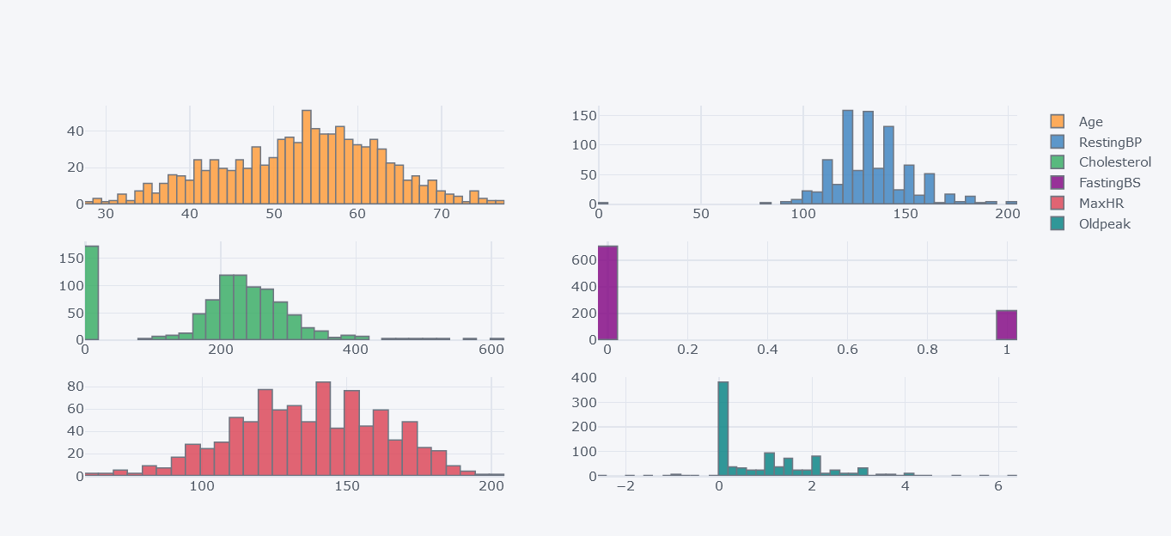
Visualization of Numerical Features

Slide 12
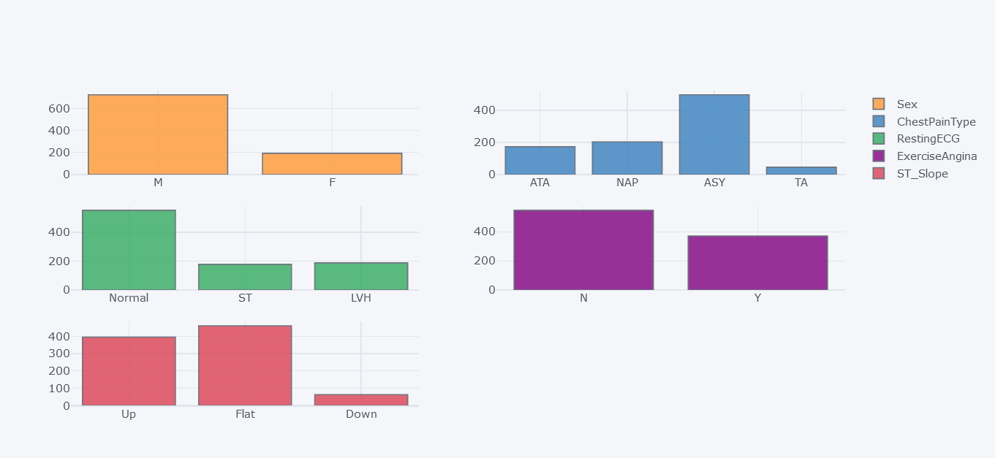
Visualization of Categorical Features

Slide 13
Models Trained
Baseline Model
Logistic & Linear Discriminant & SVC & KNN
Logistic & Linear Discriminant & SVC & KNN with Scaler
Ensemble Models (AdaBoost & Gradient Boosting & Random Forest & Extra Trees)
Famous Trio (XGBoost & LightGBM & Catboost)
CATBOOST
Catboost HyperParameter Tuning with OPTUNA

Slide 14
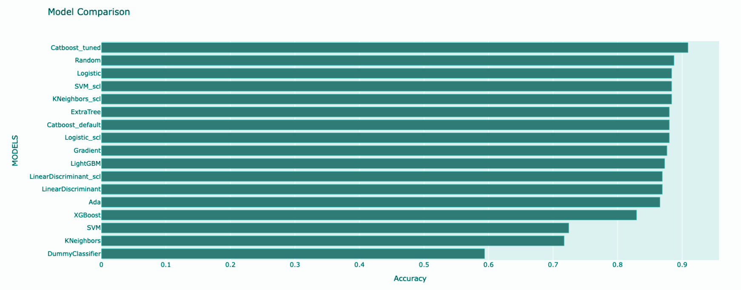
Training the Model
17 MODELS

Slide 15
Conclusion
In this project I’ve implemented Machine Learning algorithms to predict Heart Failure in Human Beings. The Final Model is able to predict the result with accuracy of 90.9%.
This project can also be used by doctors to predict chances of Heart Failure of their patients.
Anyone can access this web app by any device which have Internet connection and a browser installed.

Slide 16

Thanks
I am thankful to HOD Prof. Saurabh Sharma for his fruitful guidance.
I am also thankful to Prof. Vishal Paranjape for guidance and help.

